Slide 1
Smart Study Planner
CAPSTONE PROJECT
Presented By:
Shubhrat Chaursiya
Arya College of Engineering and IT
Information Technology

Slide 2
OUTLINE
Problem Statement
System Development Approach
Algorithm & Deployment (Step by Step Procedure)
Result
Conclusion
Future Scope(Optional)
References

Slide 3
Problem Statement
Students often face challenges in organizing study schedules and tracking academic tasks. This planner helps users create, view, and manage study goals with reminders and visual timelines. The goal is to boost productivity and time management. Tasks and progress can be saved locally

Slide 4
System Approach
Frontend Technologies:
HTML5 – Structure of the webpage
CSS3 – Styling and responsive layouts
JavaScript – Dynamic interactivity (cart, filtering, total calculation)
Design Approach:
Clean and user-friendly interface
Mobile-responsive design
Modular separation of HTML, CSS, and JS files

Slide 5
Algorithm & Deployment
Product Catalog Creation
Define product categories and details (image, price, description).
Frontend Design
Layout using HTML and CSS (grid & cards).
Interactive Features
Add-to-Cart, Remove-from-Cart functions in JavaScript.
Real-time total price calculation.
Product filtering by category.
Modal views for product details.
Testing
Cross-browser compatibility
Mobile responsiveness
Deployment
Host using GitHub Pages / Netlify for free and easy access.

Slide 6
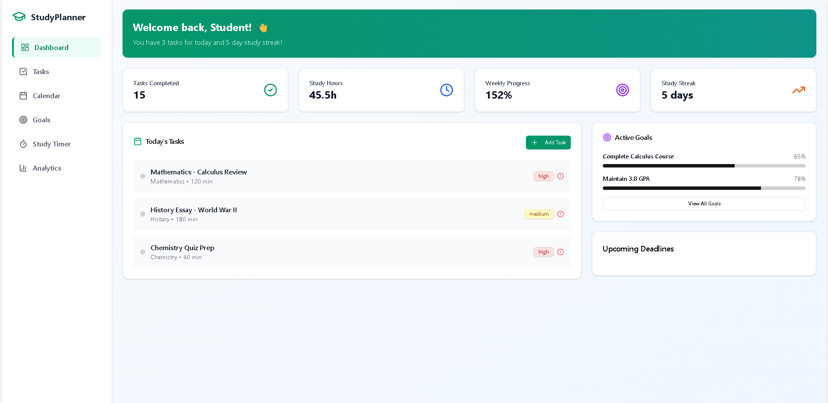
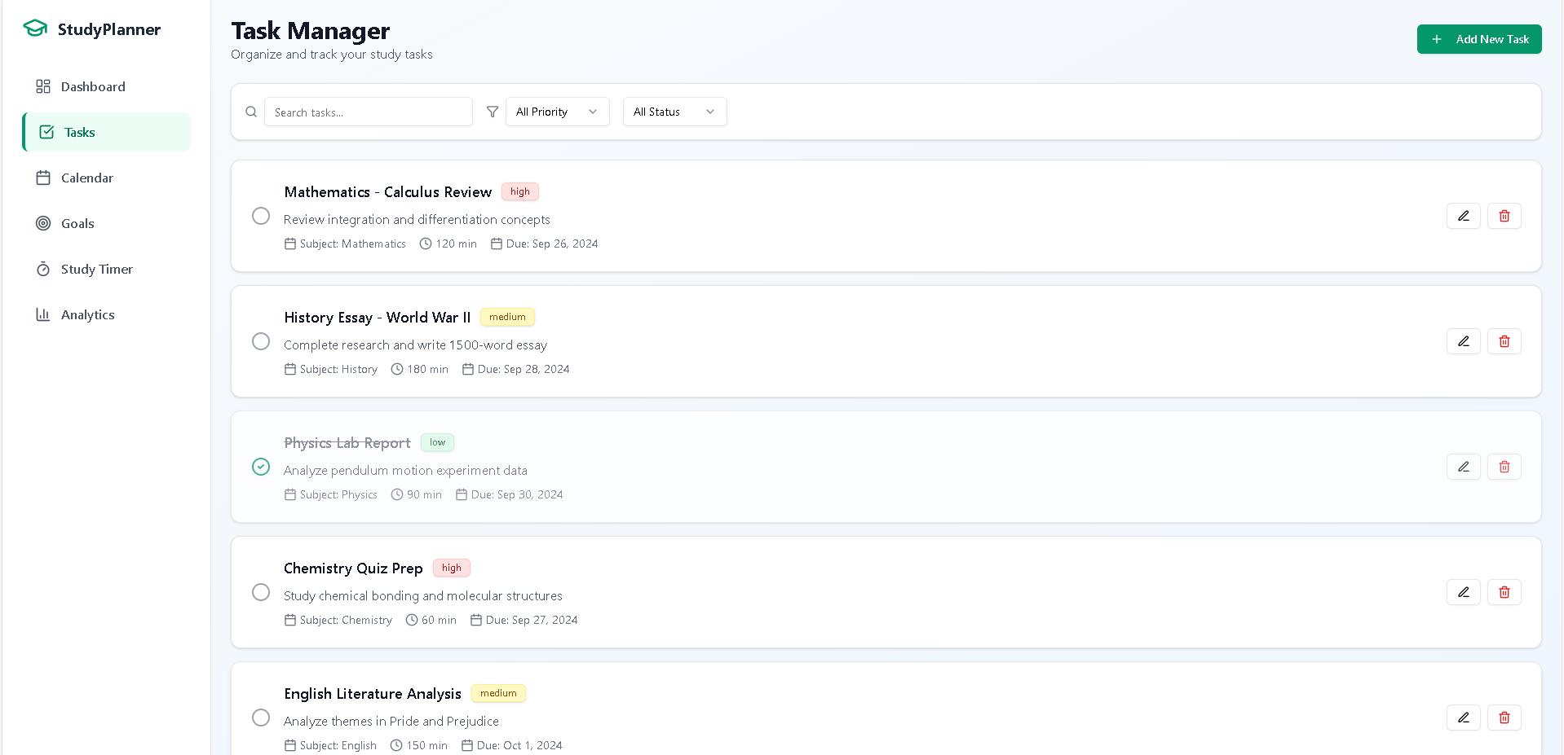
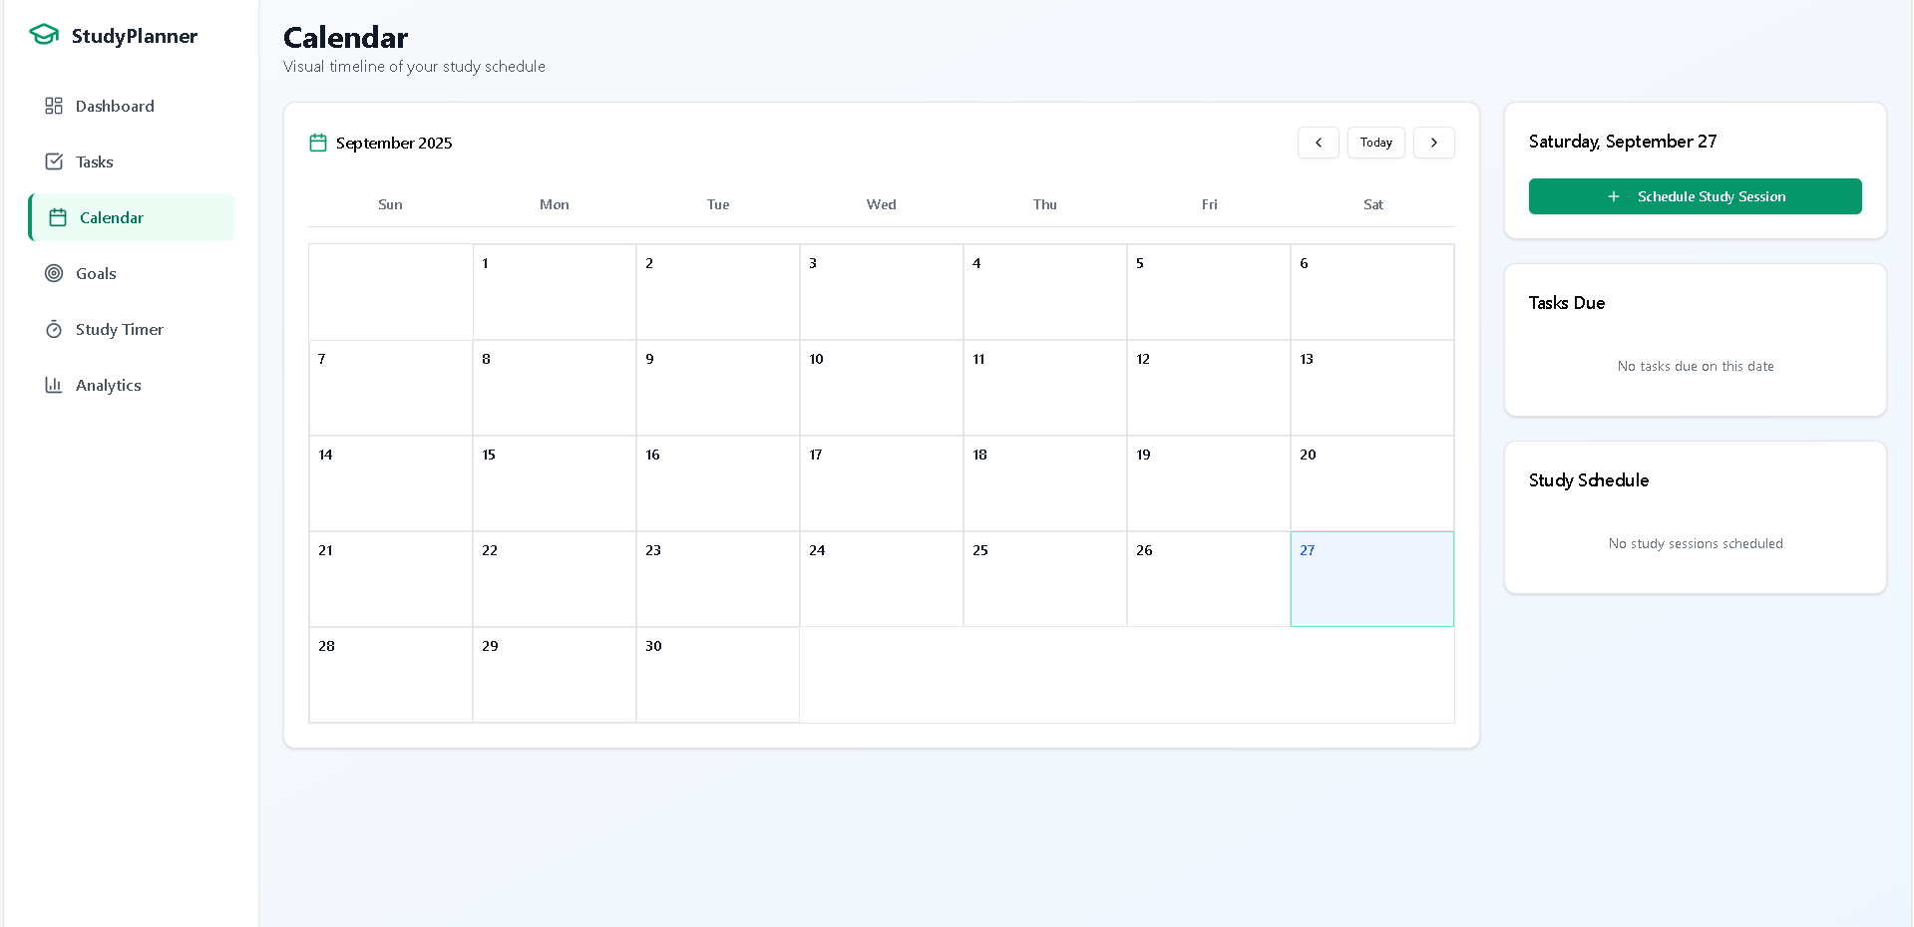
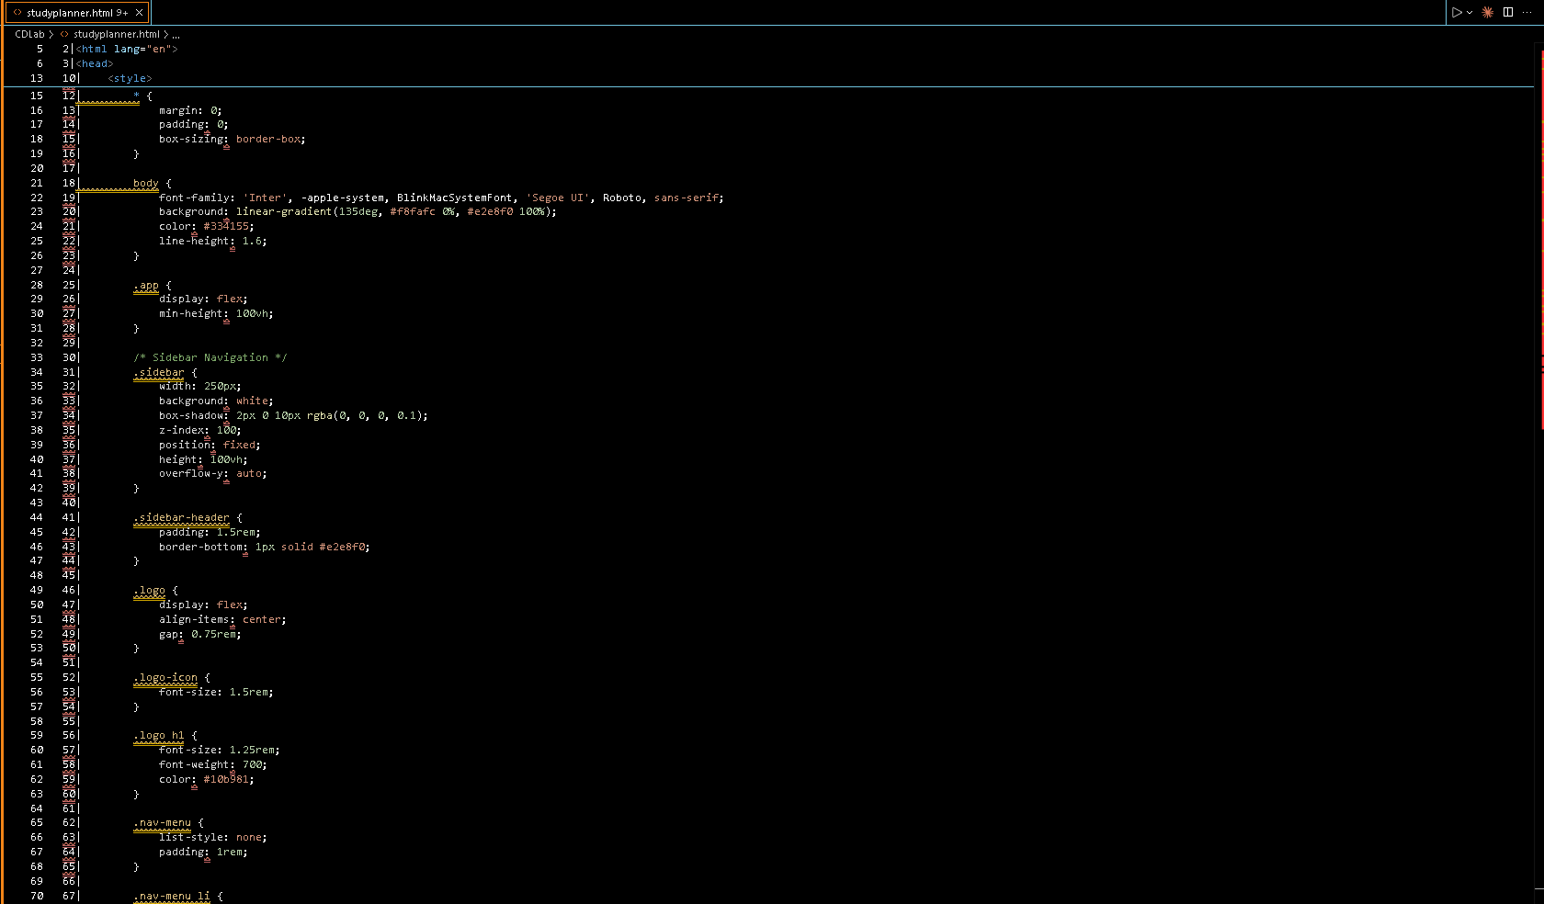
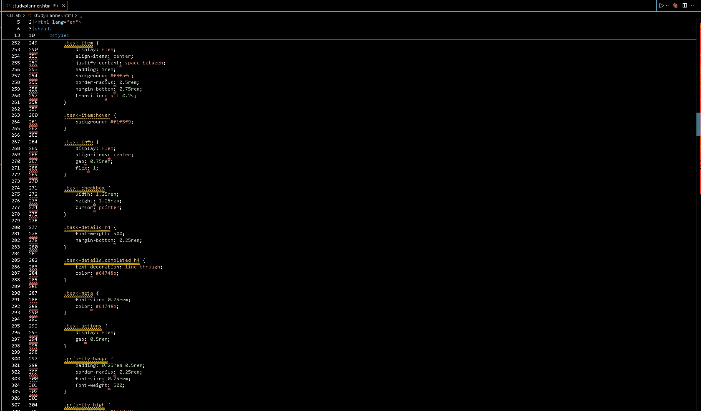
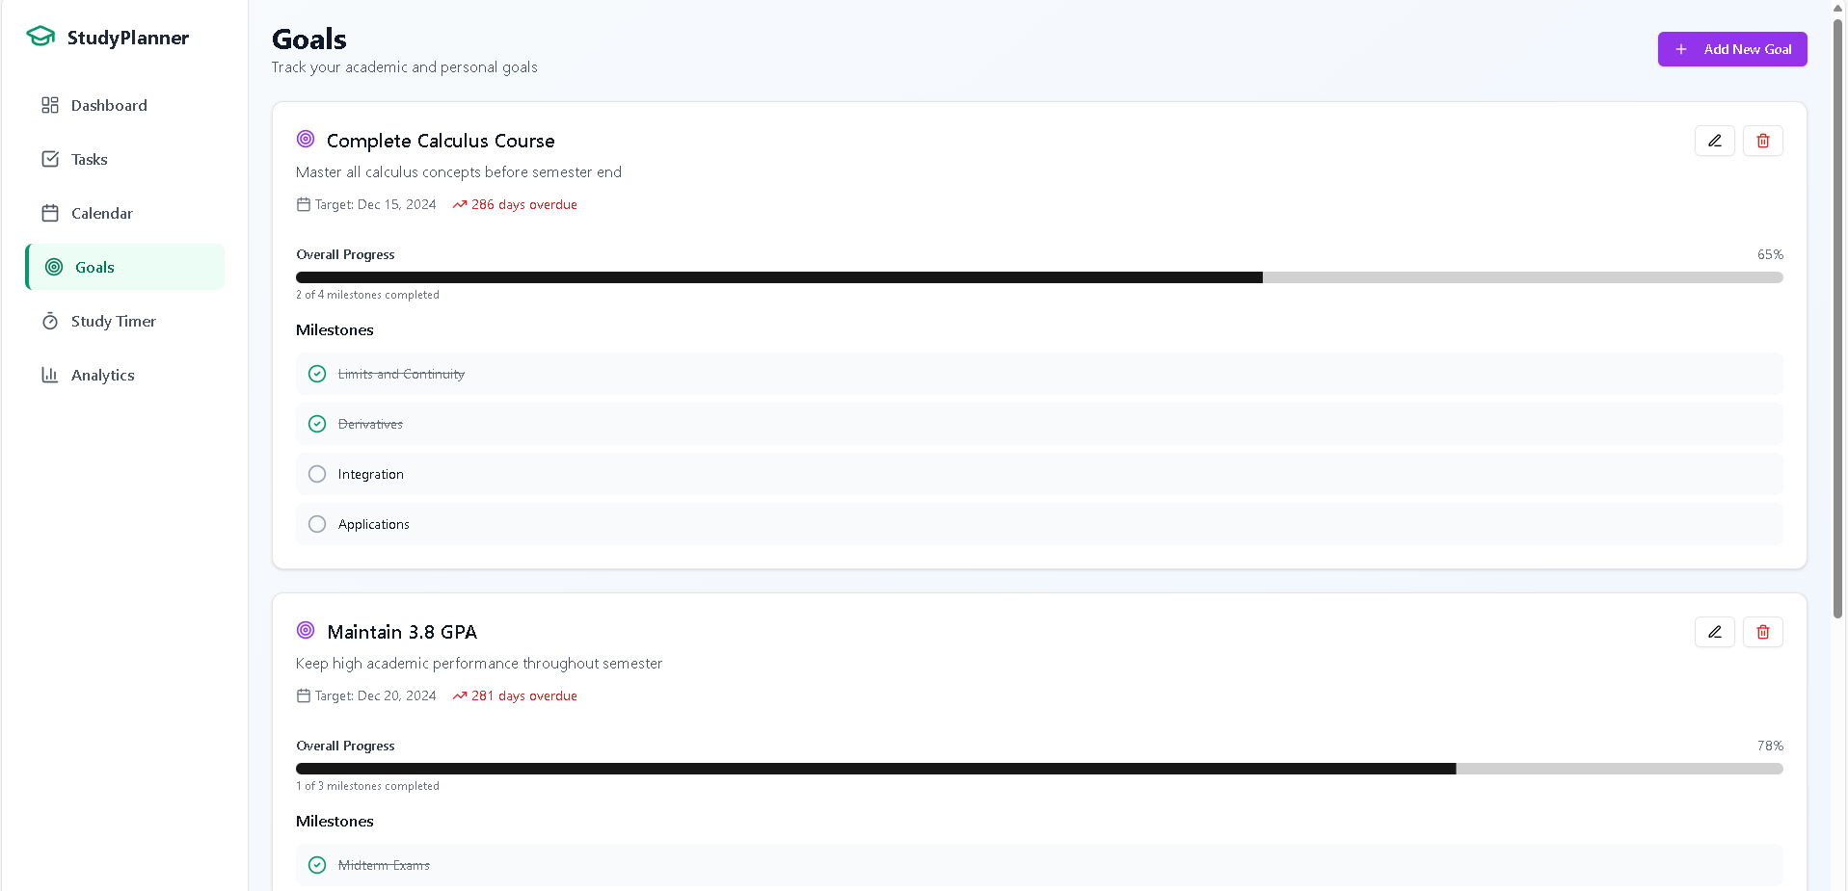
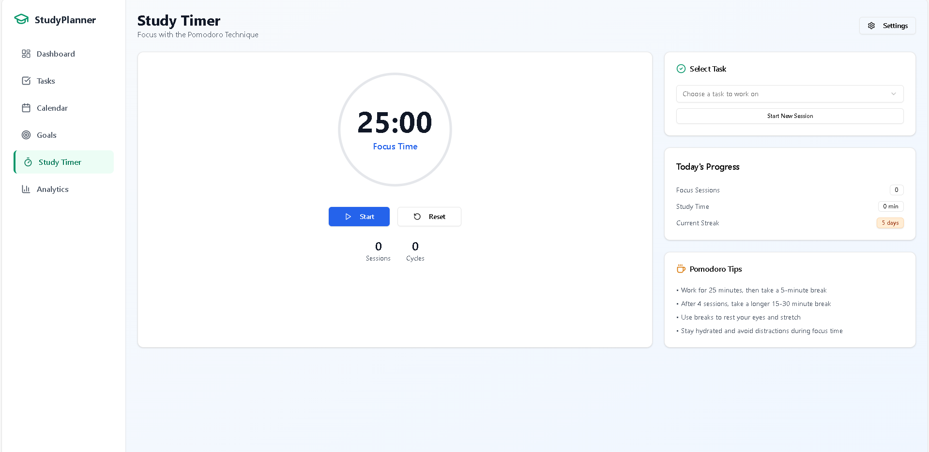
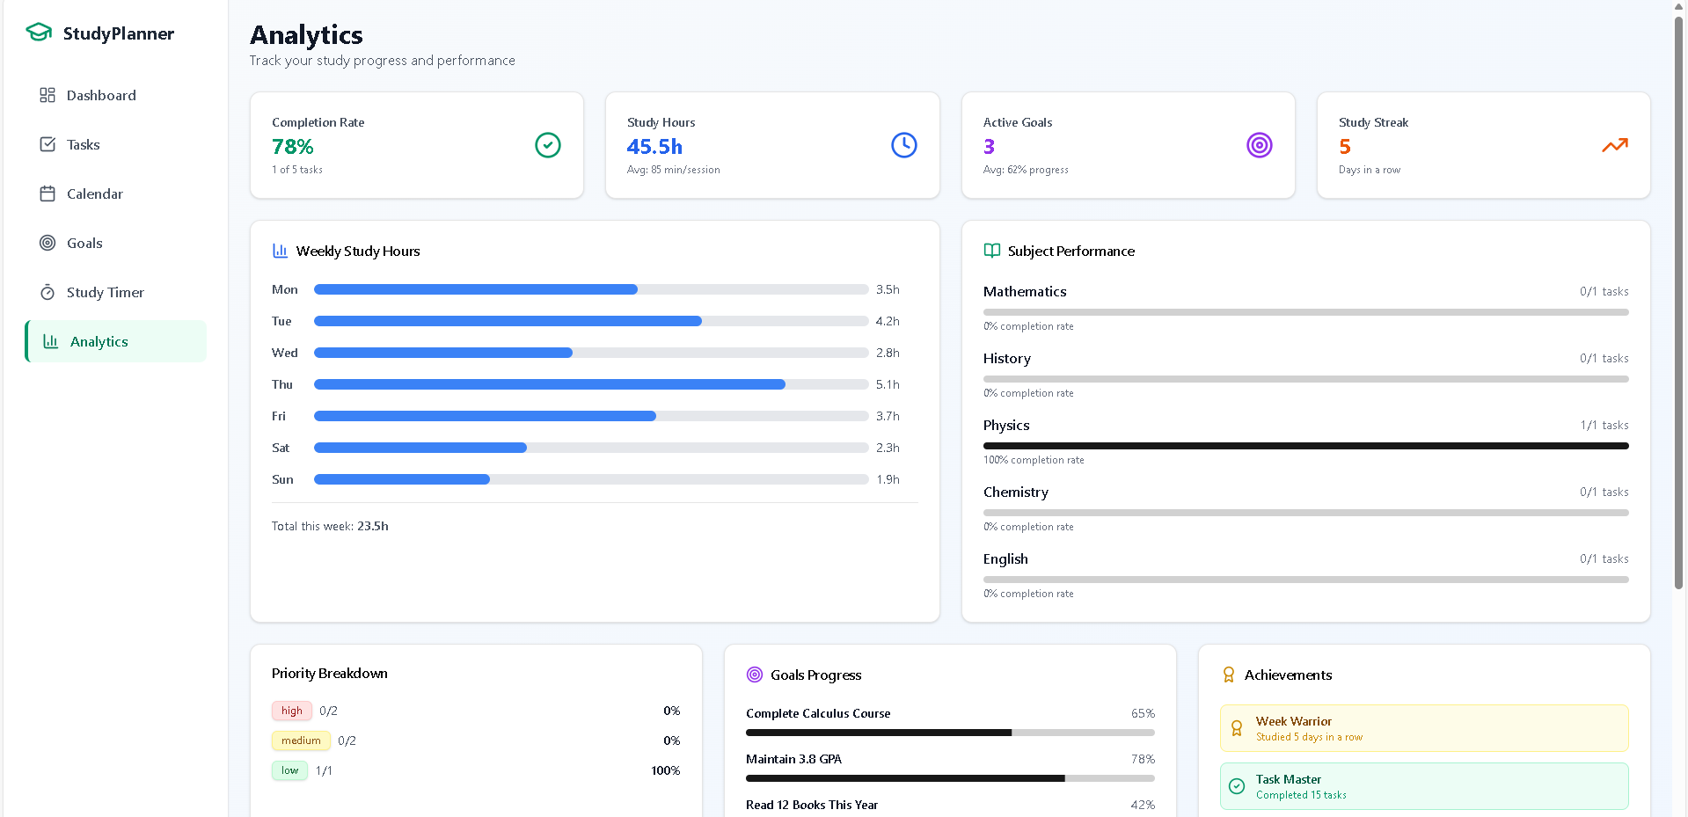
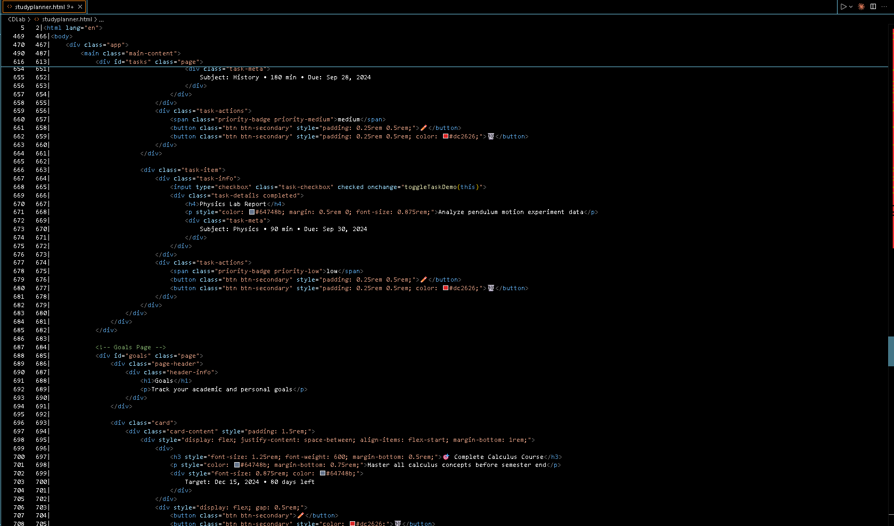
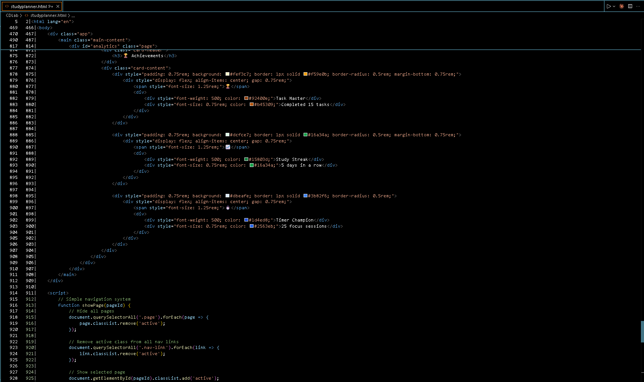
Result
Attach your Github link
https://github.com/shubhratchaursiya/Edunet-Foundation

Slide 7
Conclusion
The Edunet-Foundation Study Planner provides students with an all-in-one, easy-to-use web-based tool to efficiently organize their study schedules, set achievable goals, and track progress. By leveraging HTML, CSS, and JavaScript with local storage, it ensures data persistence without the need for server-side infrastructure, making it lightweight and accessible on any device. Features like task management, a Pomodoro timer, and analytics empower users to improve their productivity and time management. This project serves as a practical and effective solution for academic planning while offering future potential for cloud synchronization and advanced notifications to further enhance user experience..

Slide 8
Future scope
Implement cloud synchronization to enable data access across multiple devices.
Add real-time notifications and reminders for upcoming tasks and deadlines.
Introduce a dark mode toggle for improved usability and accessibility.
Enable export of progress reports in PDF or Excel formats for offline review.
Integrate with popular calendar services like Google Calendar and Outlook for seamless scheduling.
Enhance analytics with AI-based personalized study recommendations.
Add collaborative features to support group study sessions and shared goals.

Slide 9
References
"A Study Planner App: Helping Students Stay Organized and On-Track" https://www.scribd.com/document/661027328/A-Study-Planner-App-Helping-Students-Stay-Organized-and-On-Track
"AI-Based Study Planner" (Research Paper) https://ijcrt.org/papers/IJCRT2412393.pdf
"The Impact of Time Management on College Students' Study Engagement" https://pmc.ncbi.nlm.nih.gov/articles/PMC11967054/
"Designing a Digital Planner App for College Students" https://ijisrt.com/assets/upload/files/IJISRT25MAY764.pdf
"Boosting productivity and wellbeing through time management" https://www.frontiersin.org/journals/education/articles/10.3389/feduc.2025.1623228/full

Slide 10
THANK YOU

